Slide 1
Incremental Sales Analysis
Pattern
Date: 06/15/23

Slide 2
Overview
01
Keywords: Amazon, Products, Advertisement

Slide 3

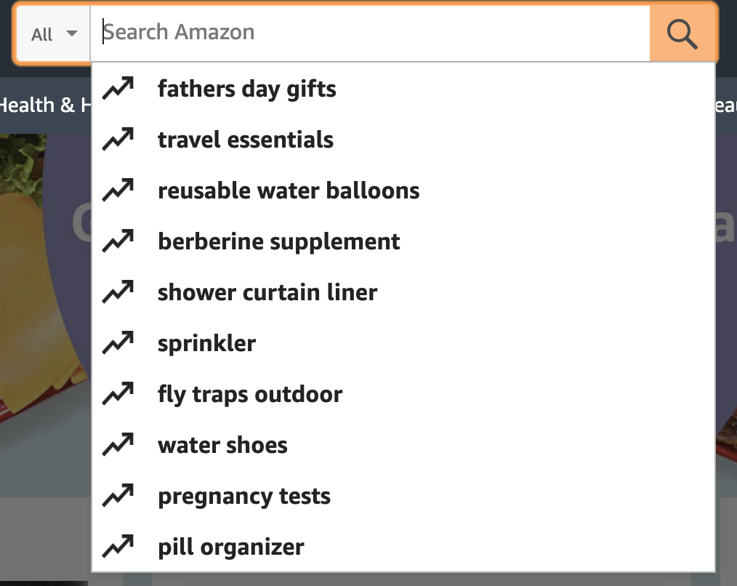
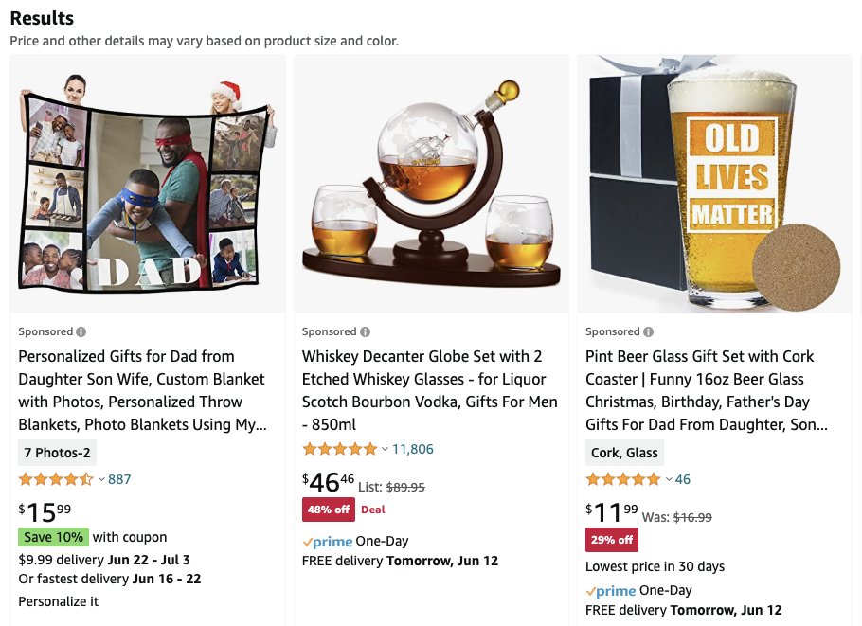
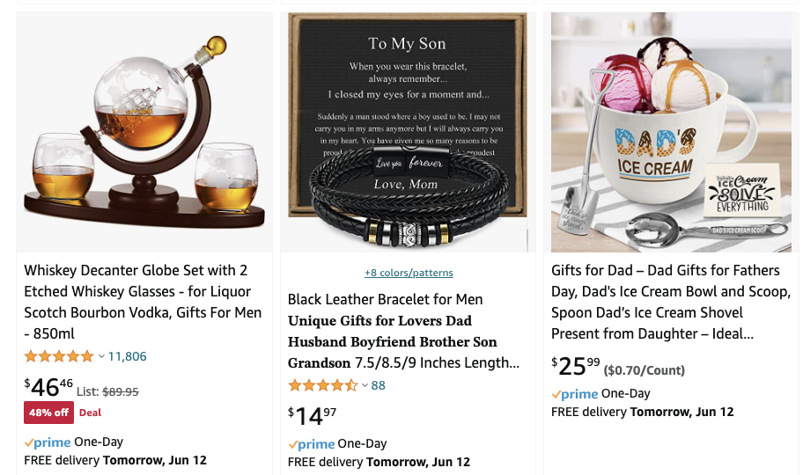

Objective: What is the advertisement effect on units sold?
Overview
Model
Solution
Results
Search Keywords
On Page 1
Top ranking products that customers see
Bid on keywords to have their products appear on the first page
On Page 5
Notes:
Customers have a tendency to purchase products that appear on the first few pages of search results.
Thus, in order to maximize sales, vendors strive to ensure their products appear on the first or second page of search results.

Slide 4
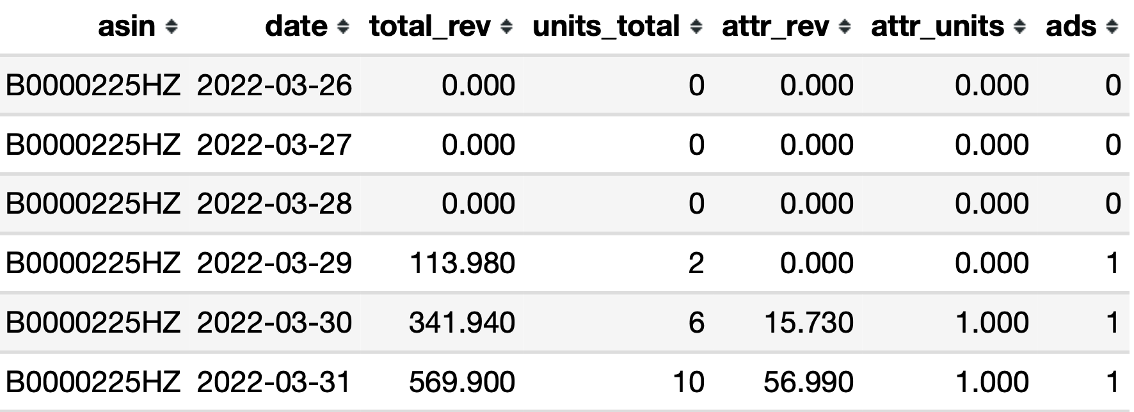
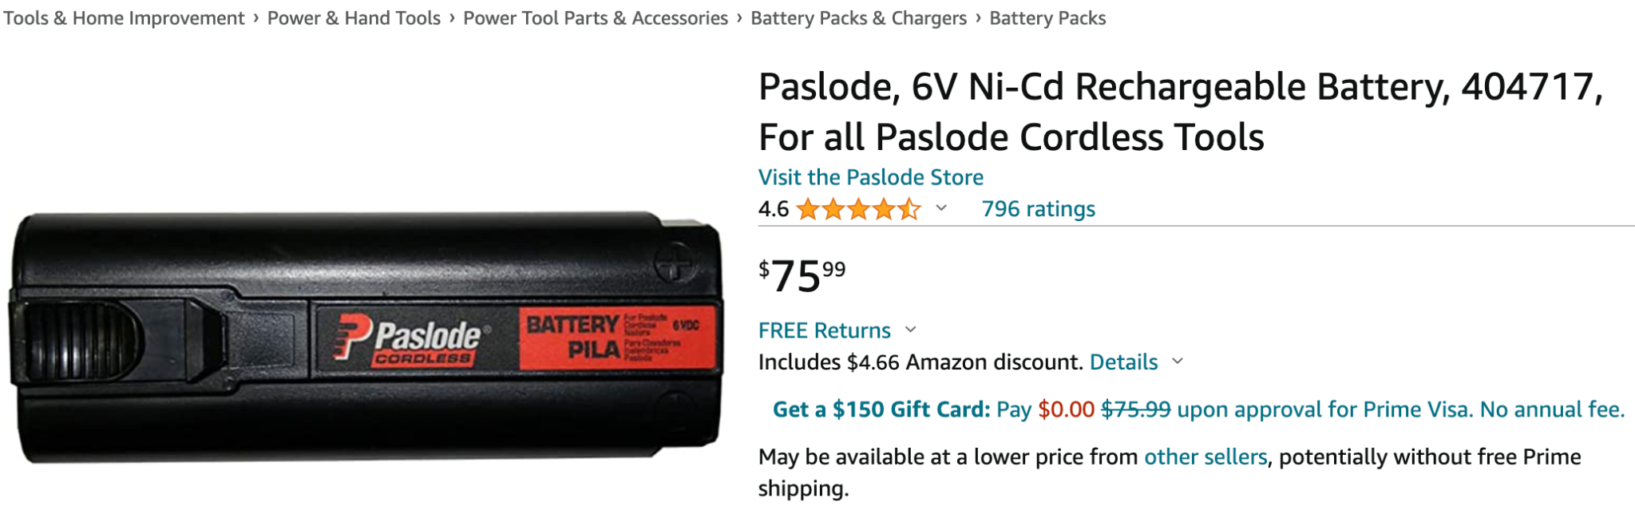
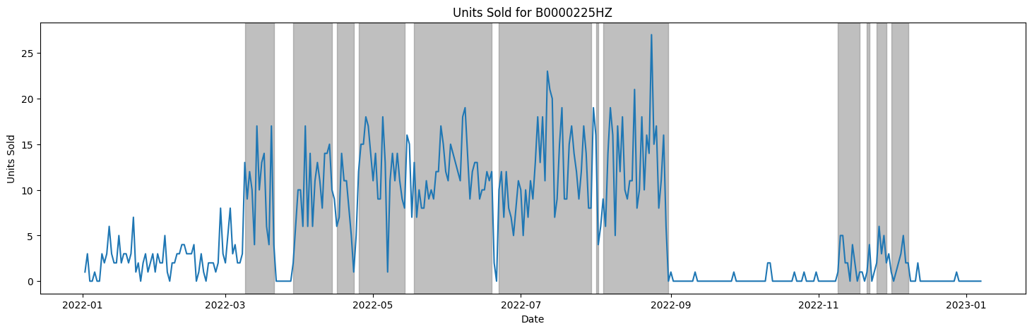
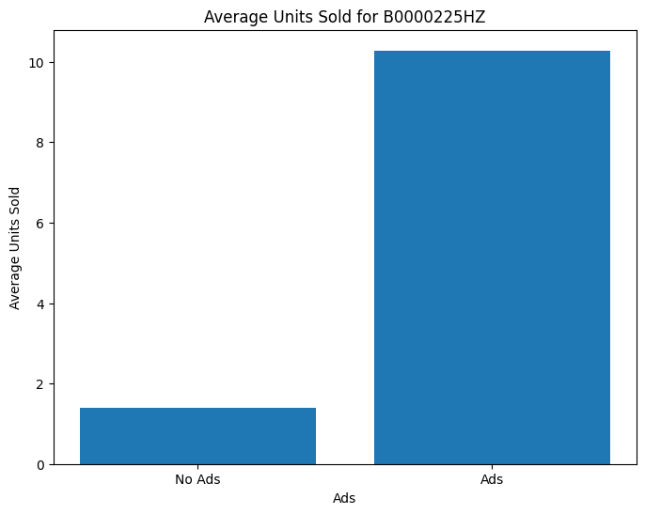
Data Source: Daily Sales Performance by ASIN
Overview
Model
Solution
Results
Date Range: 1/2/2022 - 1/7/2023
Limited to US products only
Note: The shaded interval means the advertising period

Slide 5
Model Overview
02
Keywords: DID Models, RDD Method

Slide 6
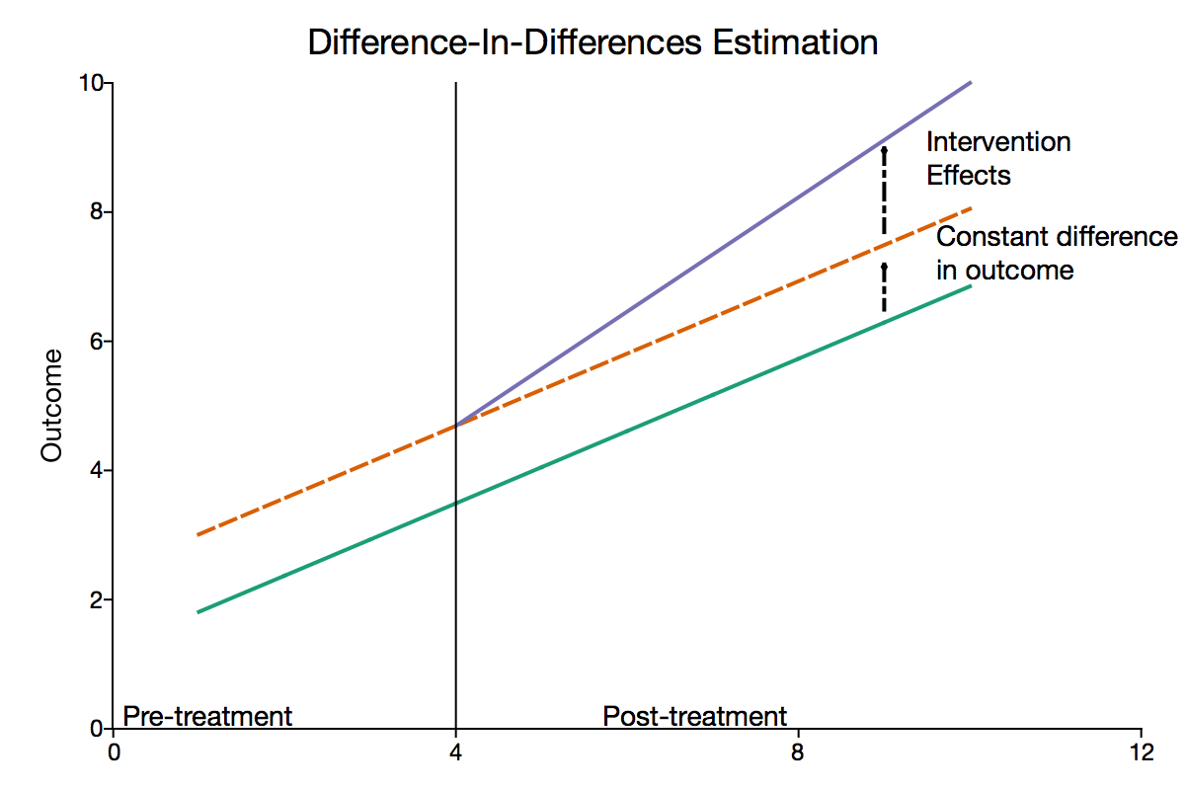
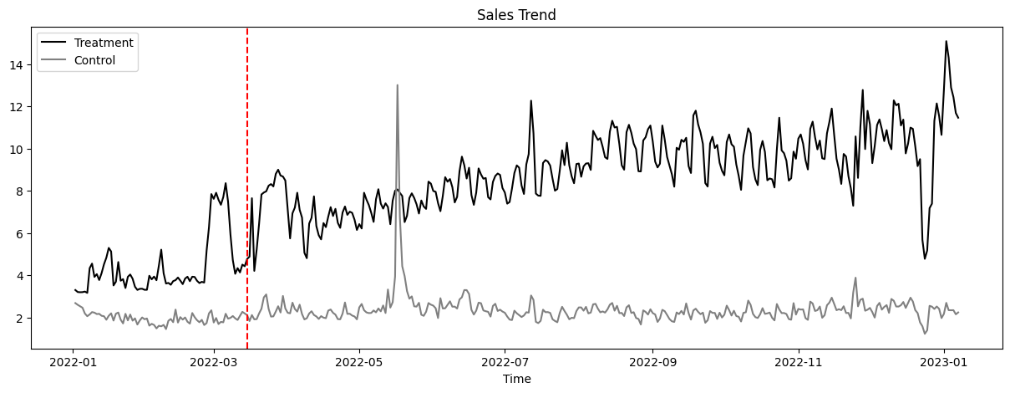

Difference-In-Differences Model: A basic model to estimate ads effect
Overview
Model
Solution
Results
Treatment Group:
Advertised most of the time
Placement of ads begins around March
Control Group:
For the most of the time, not advertised
(More than 95% of sales days have no advertising activities)
 | R-squared | 0.709
treat | -4.091e+09 | 0.894
after | 0.4142 | 0.009**
treat * after | 21.7212 | 0.000 ***
Note: Chose March 15th as the policy shock date, Treatment group line was scaled
Problems: Unsatisfied Assumptions => Unreliable Results
Violation of the parallel trends assumption due to the presence of selection bias
Lack of accurate correspondence of individual products with the ads start time

Slide 7
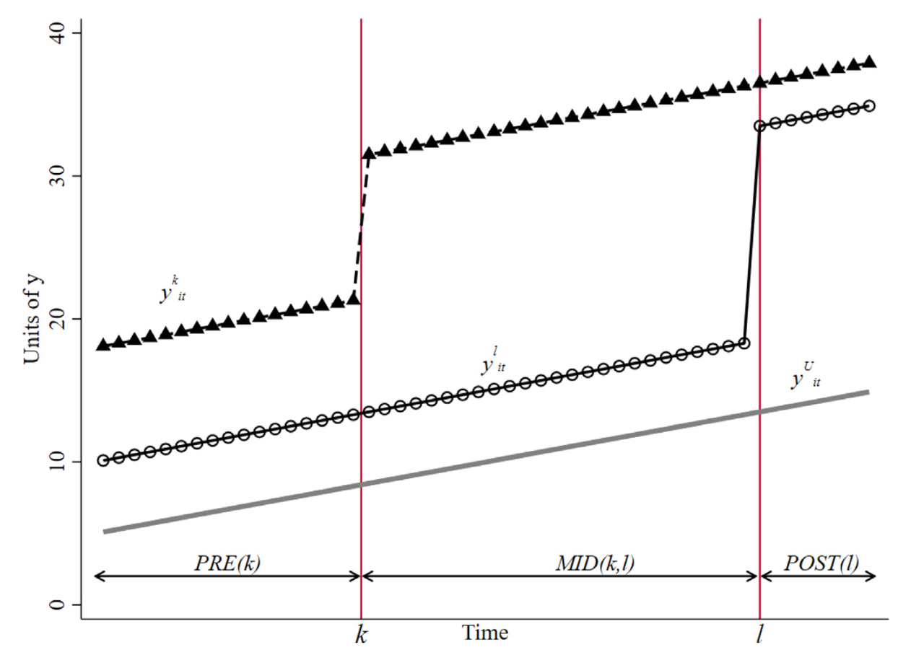
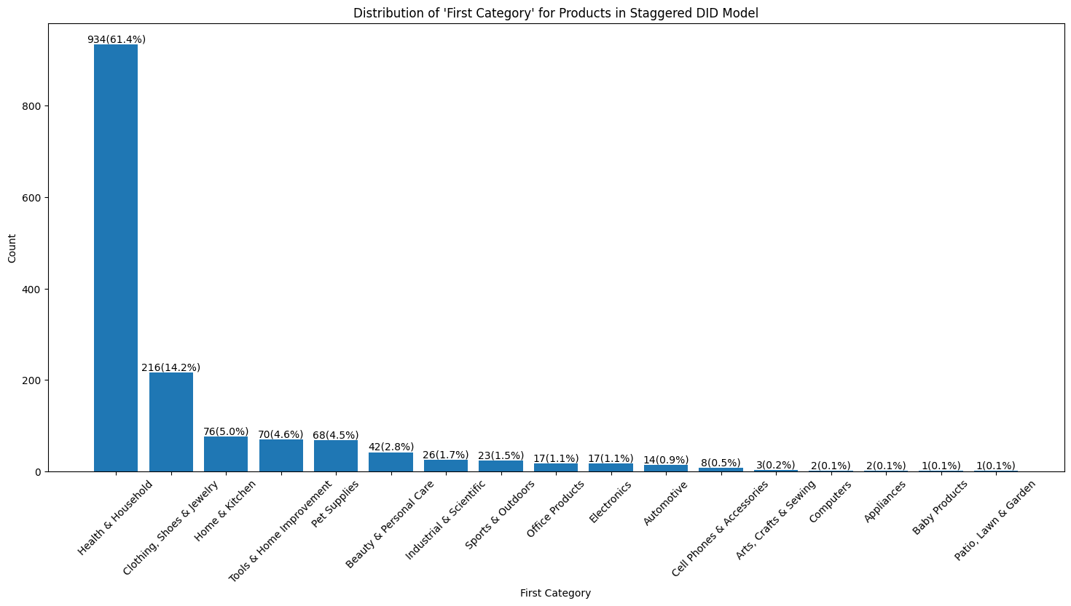
Staggered DID Model: Addressing time issue in ads effect
Overview
Model
Solution
Results
Often the case, a policy is introduced in many different individuals during many different time periods.
 | R-squared | 0.010
ads | 5.4652 | 0.000 ***
Problems: Only General Results
Multiple categories → Lack Comparability
What if I want to know the ads effect on individual products?

Slide 8
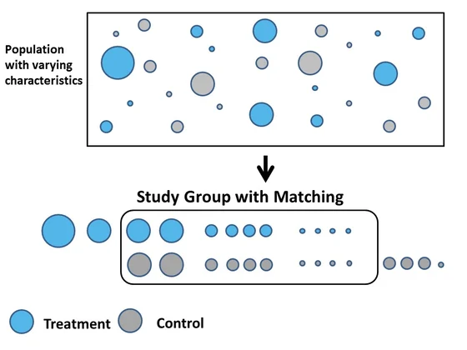

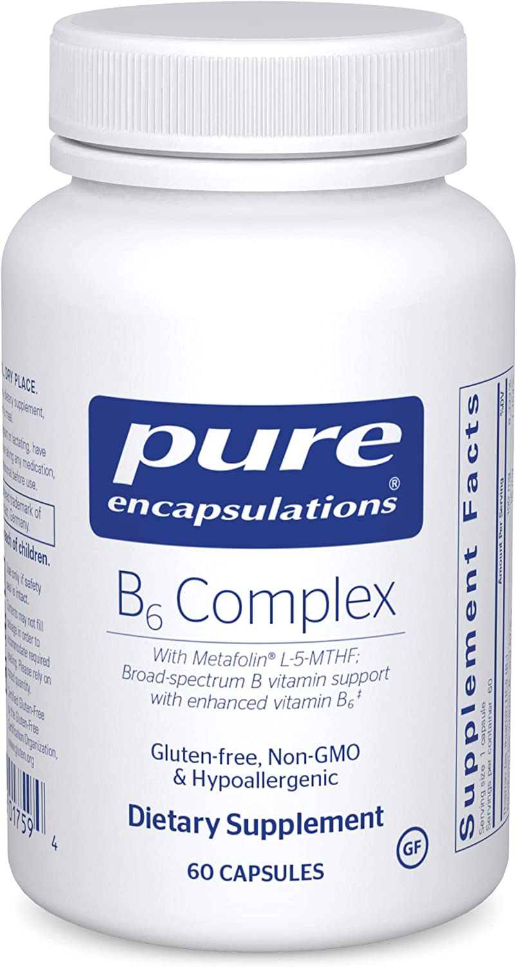

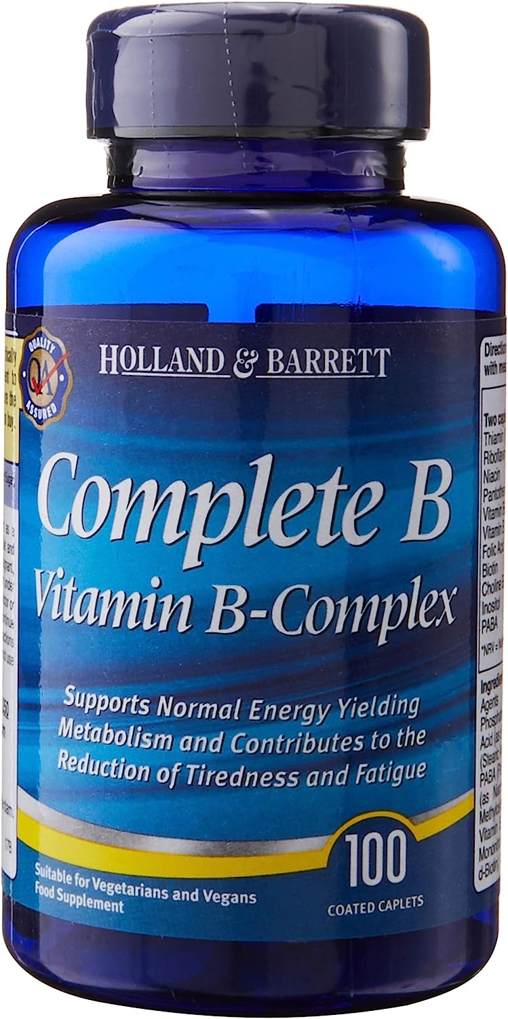
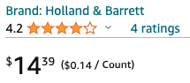

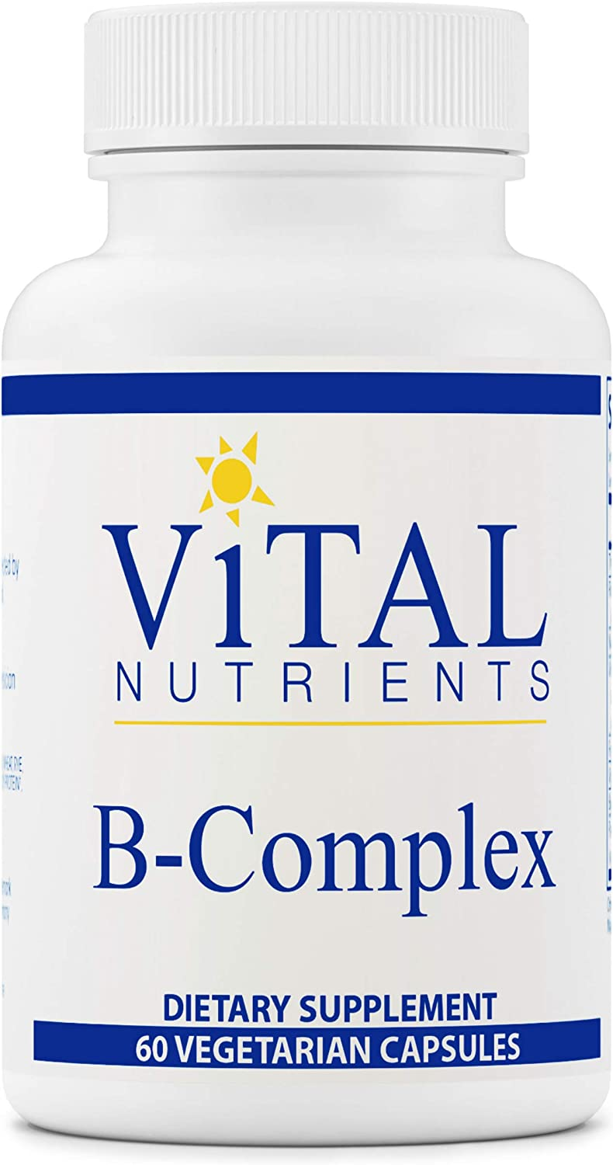
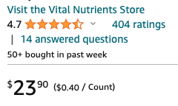

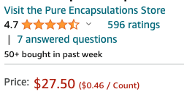
PSM-DID Model: Exploring ads effect on individual products
Overview
Model
Solution
Results
Propensity Score Matching
Treatment
Control

Slide 9
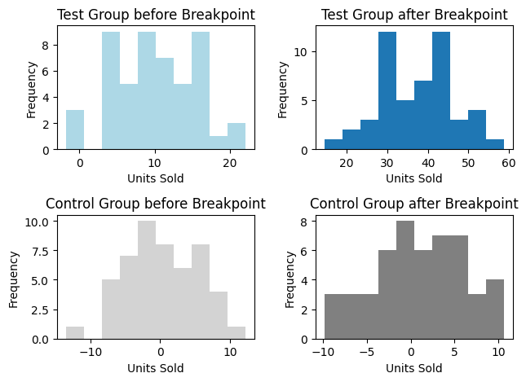
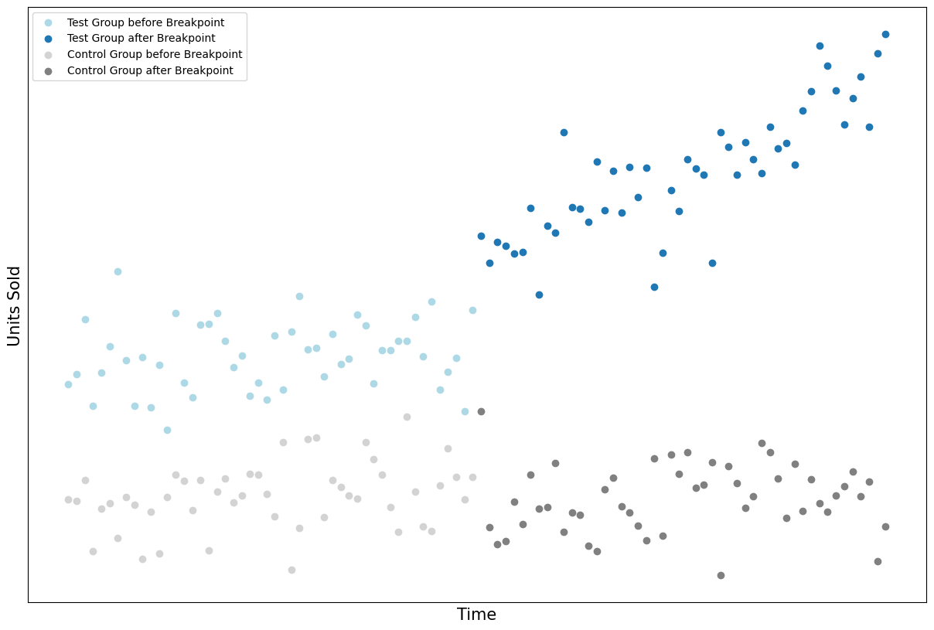


Regression Discontinuity Design: Enhancing the robustness of DID results
Overview
Model
Solution
Results
Core Idea of RDD
The distribution of observations near a threshold may exhibit a discontinuity
Significantly Different?
Core Idea of Tests
Identify the ‘discontinuity’ where a specific advertisement starts or stops for the treat product
Select data for both treat and control product for a 7-day period before / after the breakpoint
Test the consistency of the distribution
Significantly Different?
7 Days
7 Days
Wilcoxon Signed-Rank Test
Normality
Homogeneity
Sample t-test
Notes:
This allows us to be more confident that the effect of advertisement is significant

Slide 10
Matching Process
03
Keywords: Information Collection, Matching

Slide 11
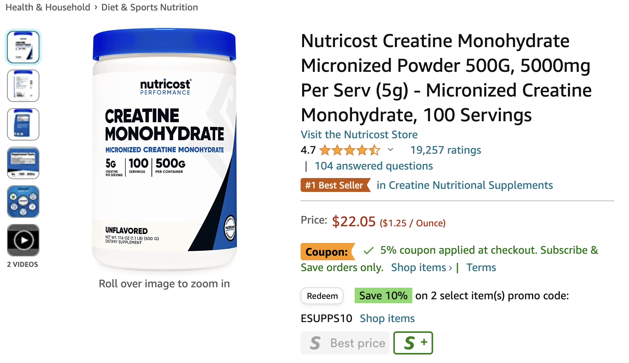
Product Classification
Overview
Model
Solution
Results
First
Second
Last
Product Type
Ratings & Reviews

Slide 12
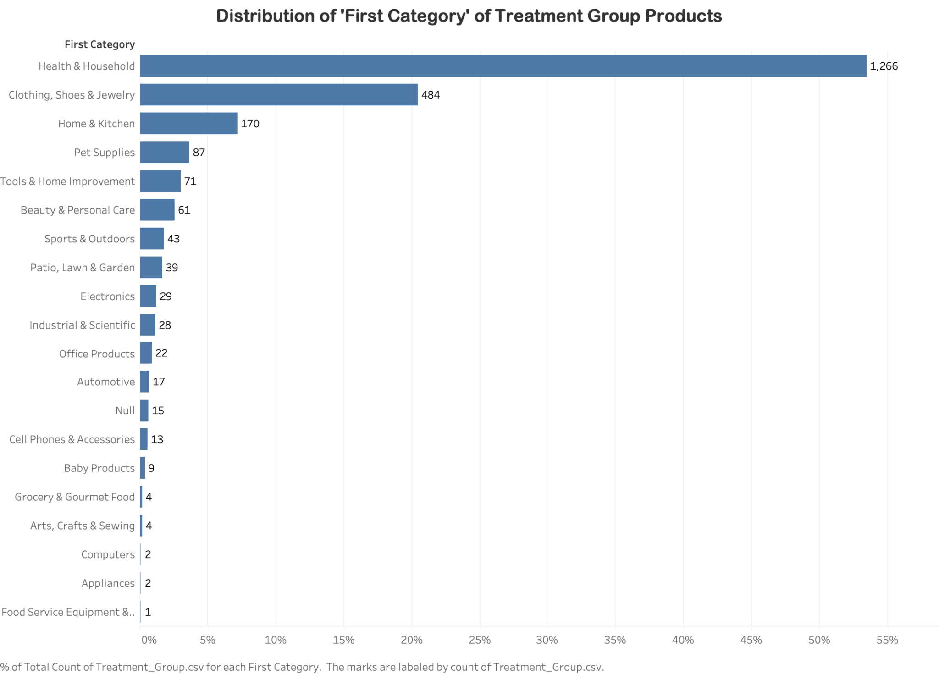
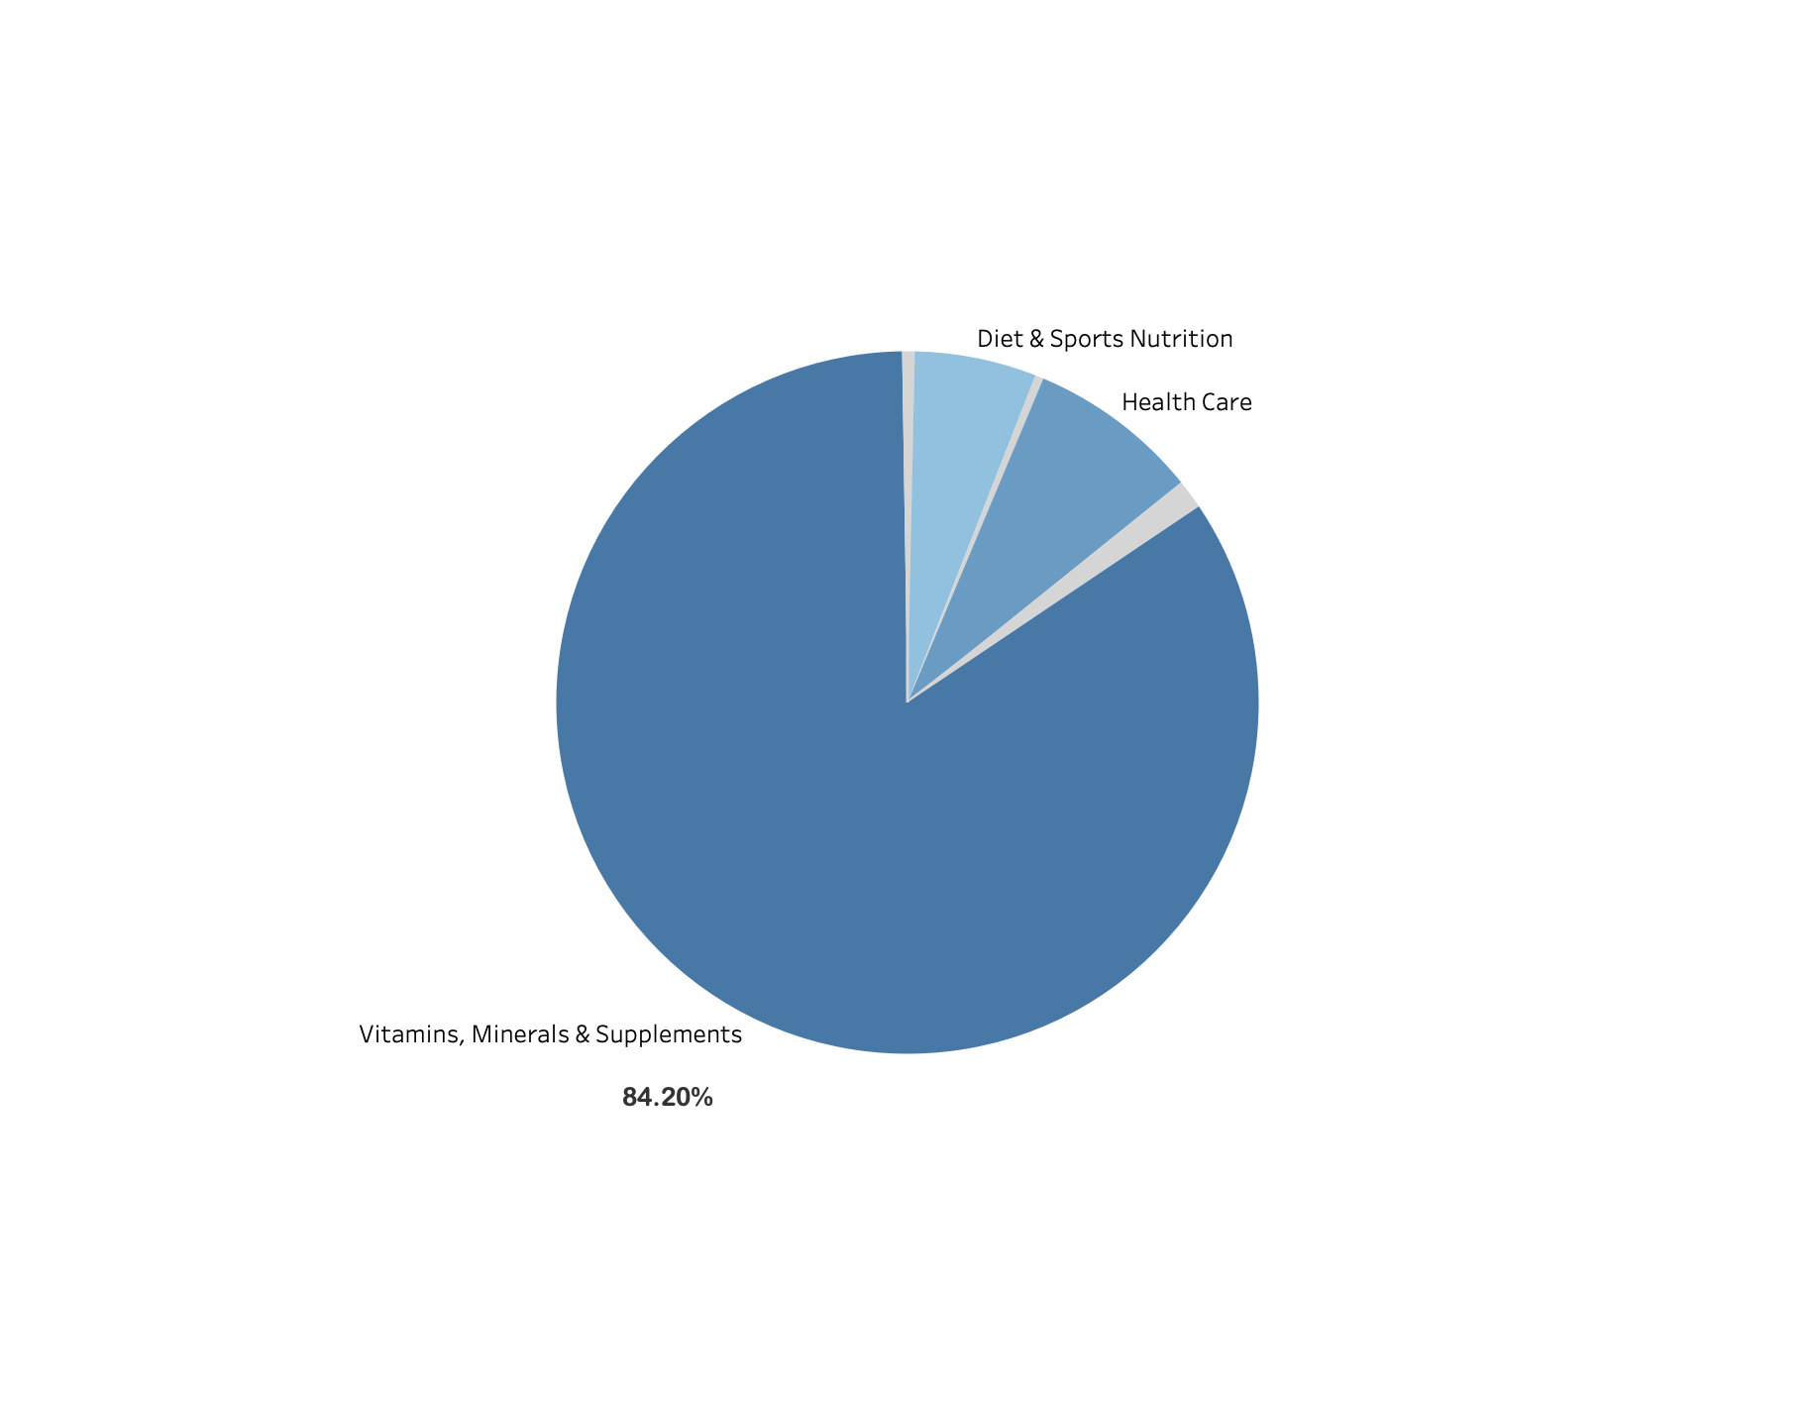
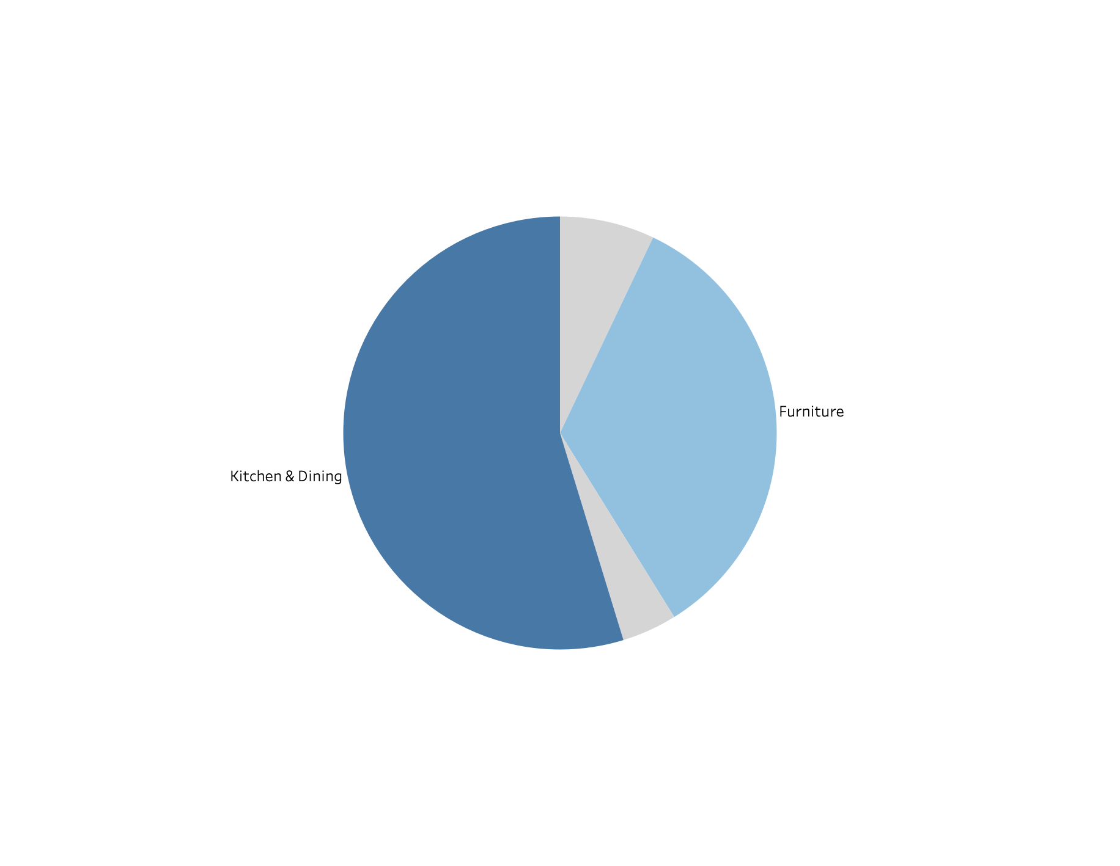
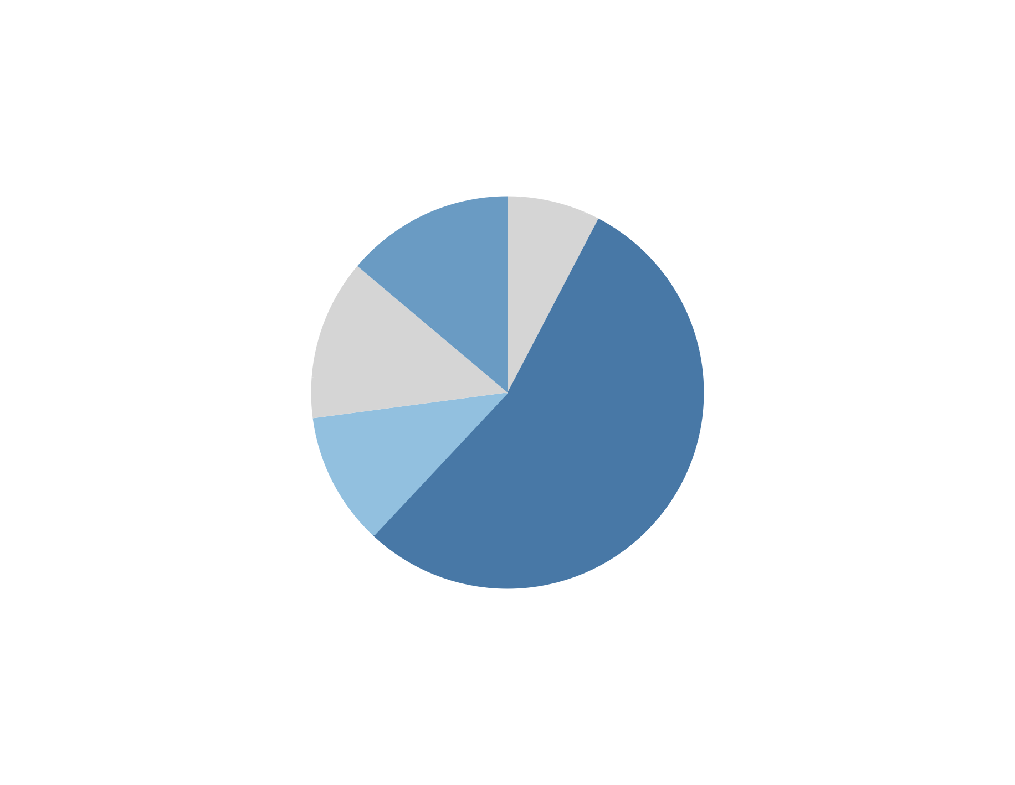
Product Classification
Overview
Model
Solution
Results
Analysis is limited to the top 3 categories:
Health & Household, Clothing, Shoes & Jewelry, Home & Kitchen
Diet & Sports Nutrition
Health Care
Women (Socks)
Vitamins, Minerals & Supplements
Furniture
Kitchen & Dining
(Socks)
Men (Socks)

Slide 13
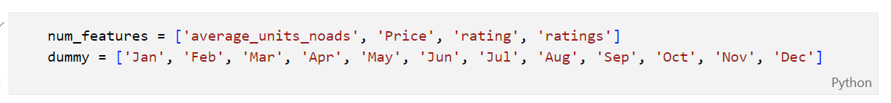
Matching Procedure
Overview
Model
Solution
Results
Matched products based on the similarity score (or propensity score).
Similarity score is calculated between each product using Model and Manual Method.
Basic Information
of Each Product
Sales Information
of Each Product
Treatment Group
First Category
Second Category
Last Category
Method 1
Model: Probability
Logistic Regression
(Top 3 Category)
KNN
Select Best Matched
Similarity Score
Matching
DID
Minimize
Method 2
Manual Calculation
Prioritizes matching within the smallest category.
Linalg Method + Jaccard Similarity
Control Group

Slide 14
Results & Conclusion
04
Keywords: Incremental Revenue, Other Insights

Slide 15
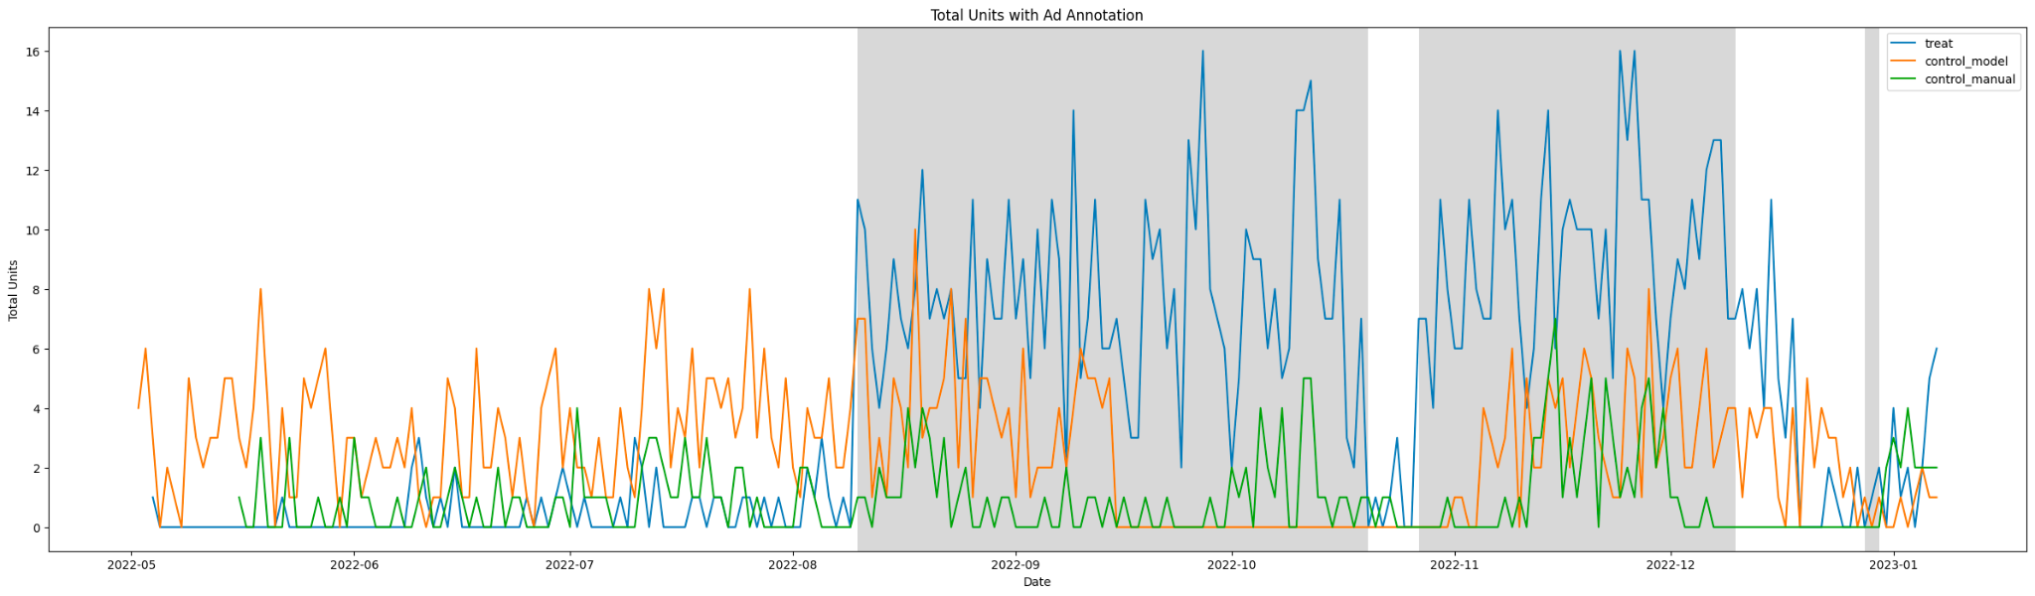
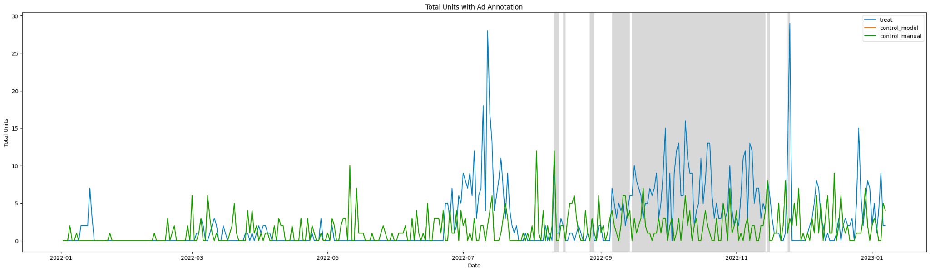
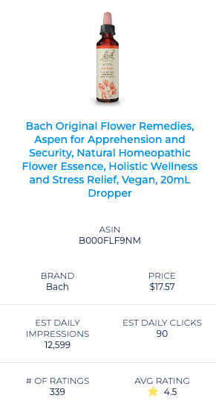
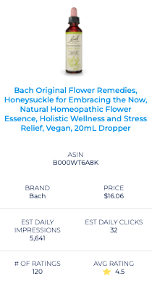
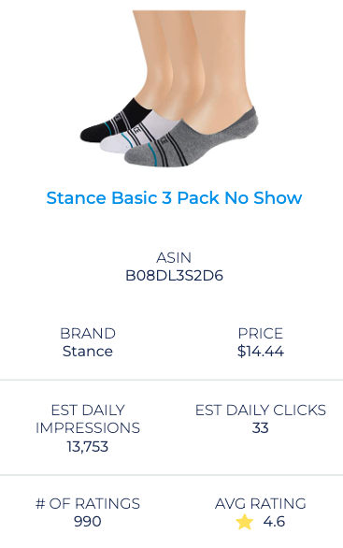
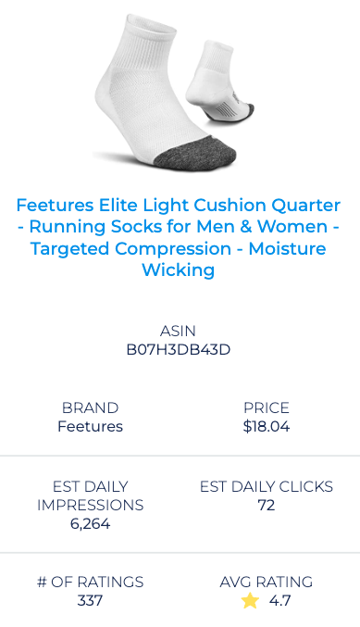
Examples
Overview
Model
Solution
Results
Health & Household
Clothing, Shoes & Jewelry
Control Asin(Manual)
Control Asin(SAME)
Treat Asin
Treat Asin
ads | R-squared | P-value
7.4752 | 0.540 | 0.000***
ads | R-squared | P-value
4.3722 | 0.235 | 0.000***
 | Treat | Control
Robustness Test | Y | N
 | Treat | Control
Robustness Test | Y | N
Notes:
The distribution of observations near a threshold may exhibit a discontinuity
If the data for the test group showed a big change around a certain point, but the control group didn't, we felt more confident in our results from DID.

Slide 16
Thank you for
watching.

Slide 17
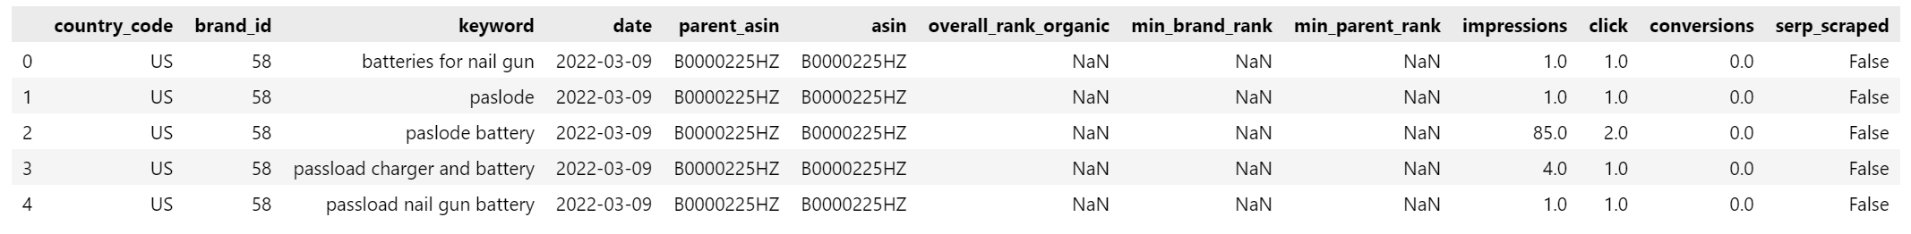
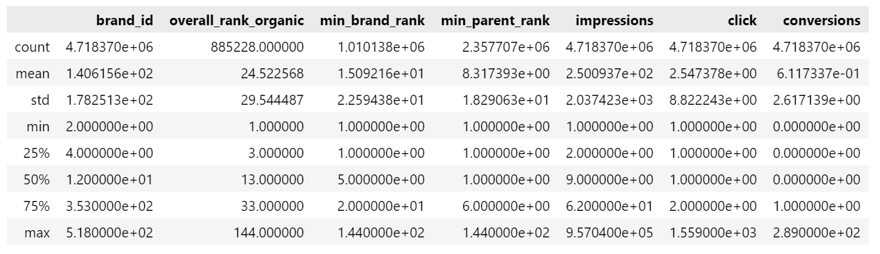
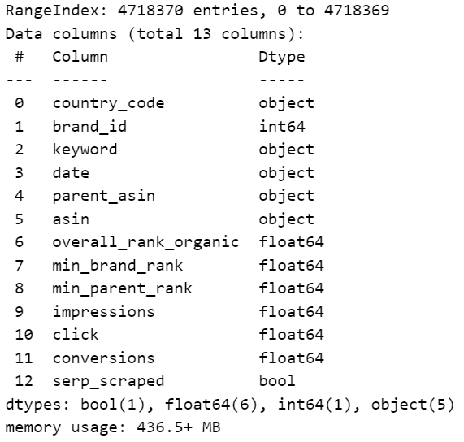
Data Sources
4718370
Ads Data (ucla_study_ads_and_total_units.csv)
Sales Data (ucla_study_selected_organic_rank_ads.csv)
Relate to the future work:
· date
· asin
· total rev
· units total
· attr_rev
· attr_units
Advertising Performance by ASIN, Date, and Keyword with Organic Rank
Limited from 1/2/2022 - 1/7/2023
Removed exact duplicate records
Limited to US products only
Results in 4,718,370 records

Slide 18
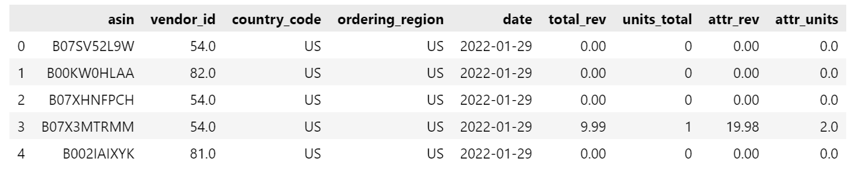
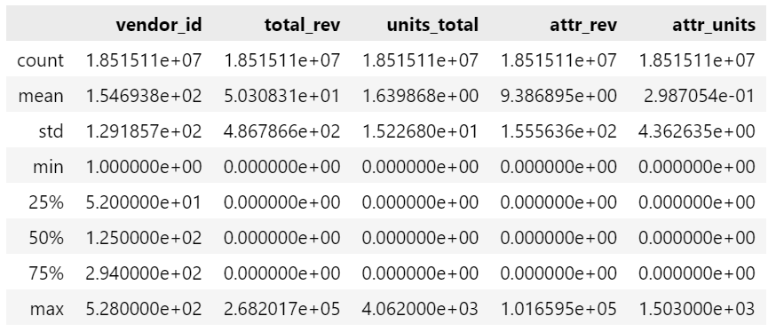
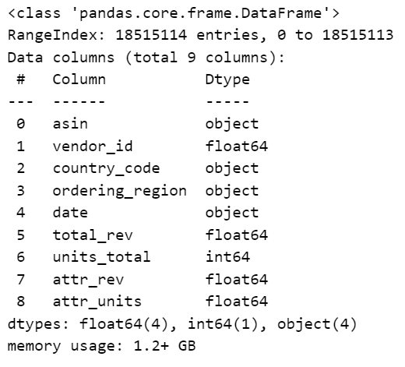
Data Sources
4718370
Ads Data (ucla_study_ads_and_total_units.csv)
Sales Data (ucla_study_selected_organic_rank_ads.csv)
Sales Data by ASIN and Date
Limited to 1/2/2022 - 1/7/2023
Removed products with 'NOASIN'
Dropped records missing Vendor ID
Limit to US Records
Results in 18,515,114 records

Slide 19
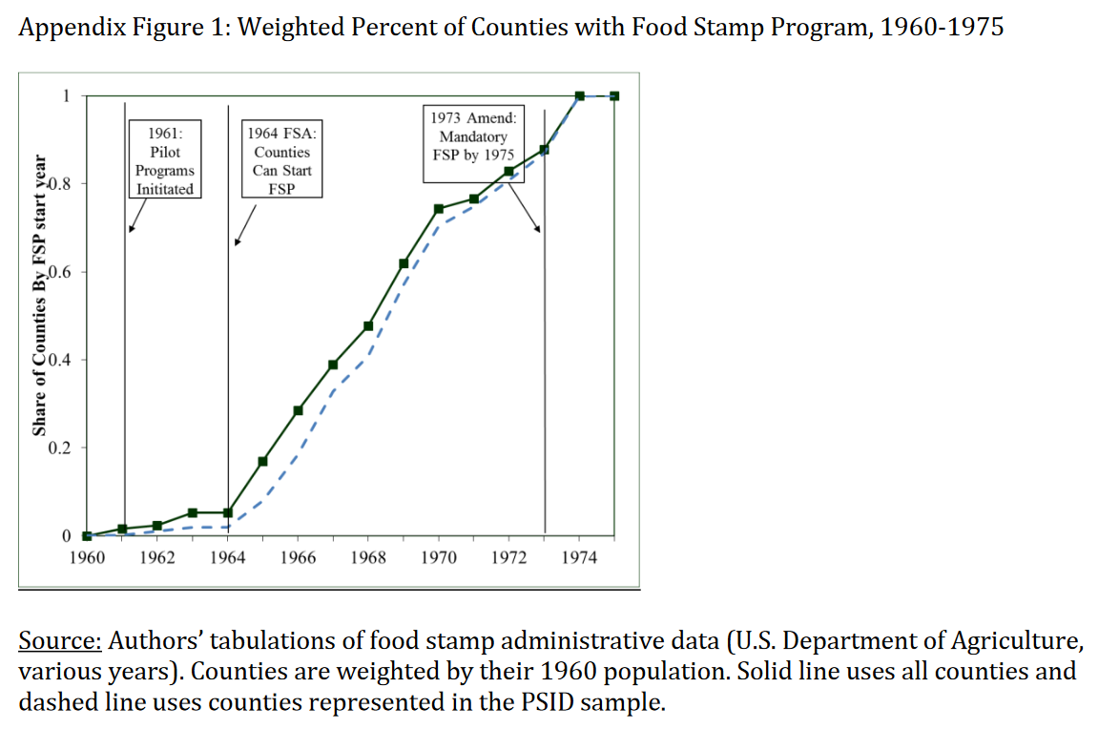
Staggered DID Model
Classic DID Model
Staggered DID Model
RDD Model
Often, a policy is introduced in many different states during many different time periods.
This is what researchers refer to when they talk about a staggered Difference-in-Difference (DID) Design,
or a generalized Difference-in-Difference.

Slide 20
Identifying Comparable Products: Interactive & PSM+KNN Method
Products are assigned a merchant category which is gathered from Amazon.com
Similarity score is calculated between each product using PSM and Manual Method
Animation
For Numerical Features, we calculate their score using Linalg Method;
For Dummy Variables, we calculate their score using Jaccard Similarity.
Similarity Score
Minimize
Manual
Treatment
&
Control Group
Original Data
Data Processing
Model Selection
DID Analysis
Results
PSM+KNN
KNN
(K-nearest-neighborhood)
Using Logistic Regression, we calculate the propensity score of all products (which shows the degree of similarity).
Similarity Score
First Category
Second Category
Last Category
Our approach prioritizes matching within the smallest category.

Slide 21
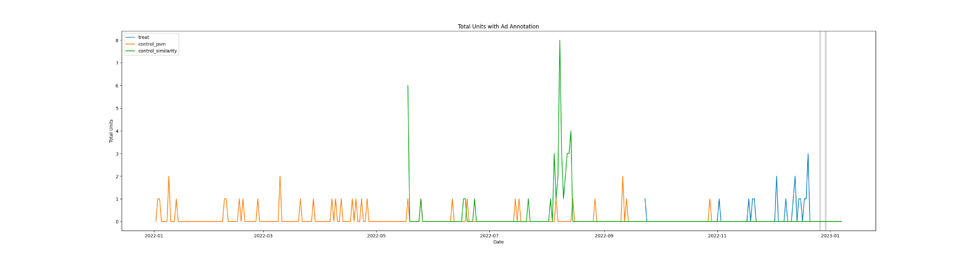
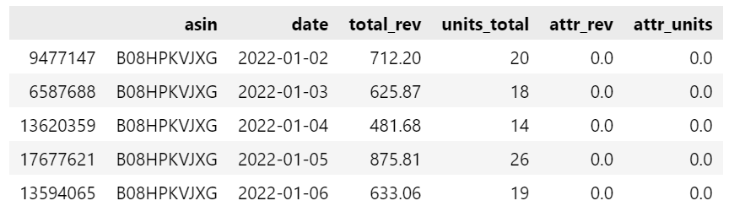
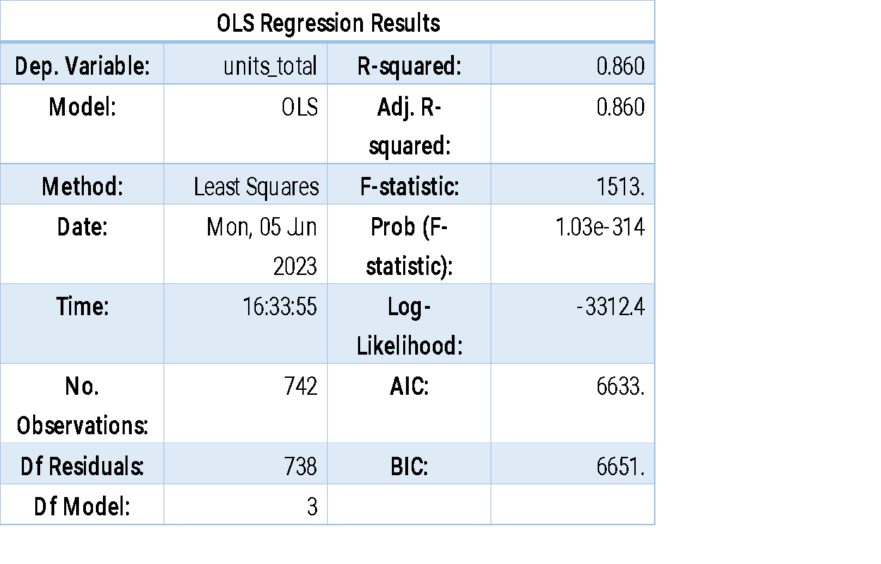
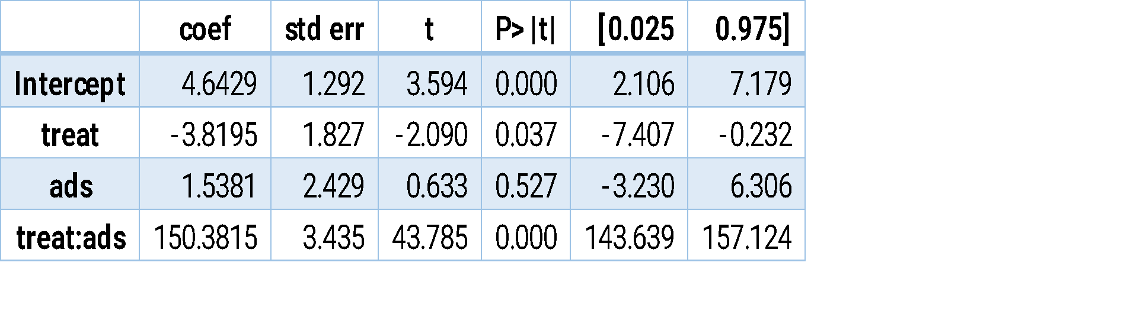
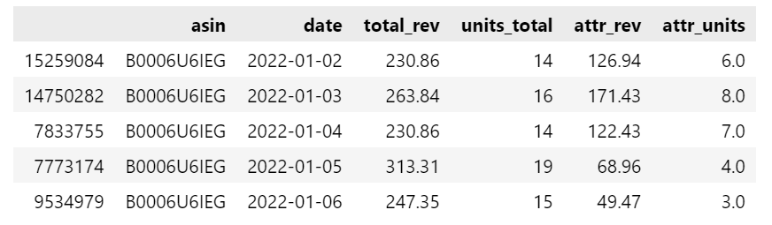
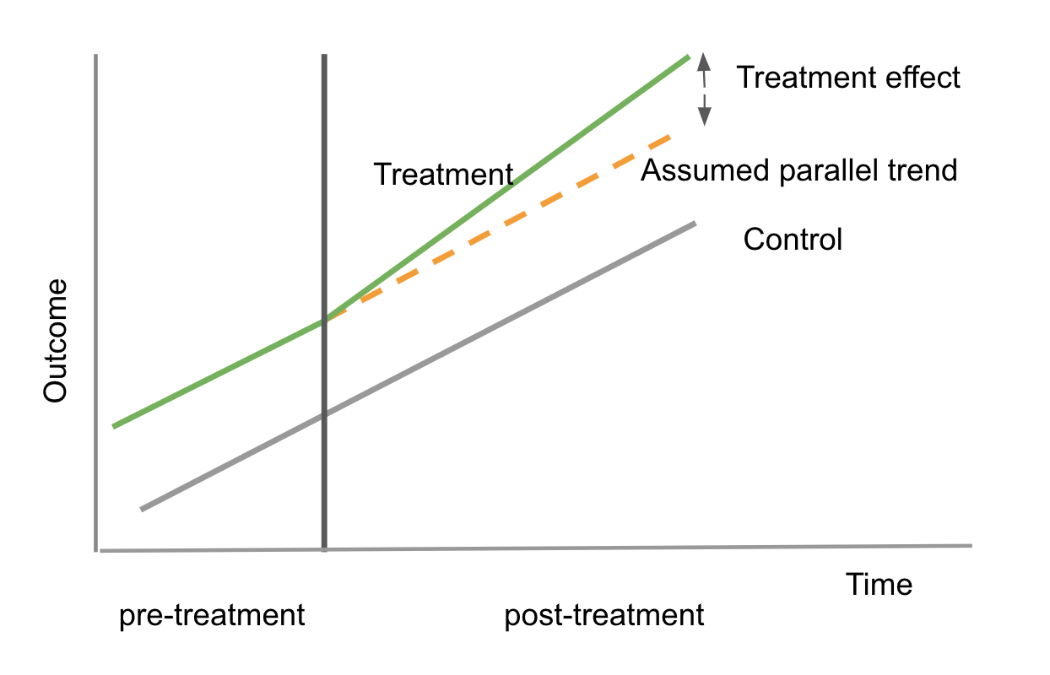
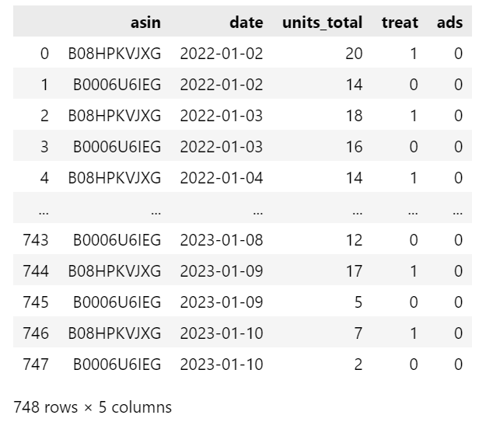
Example Results and Analysis

Slide 22
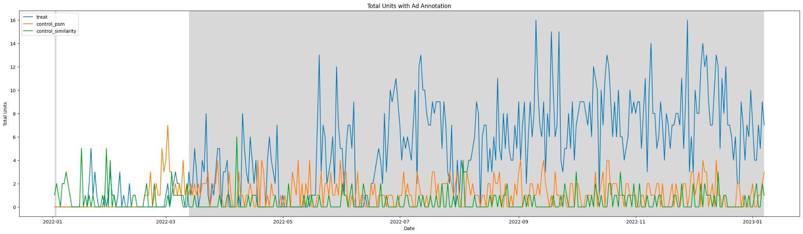
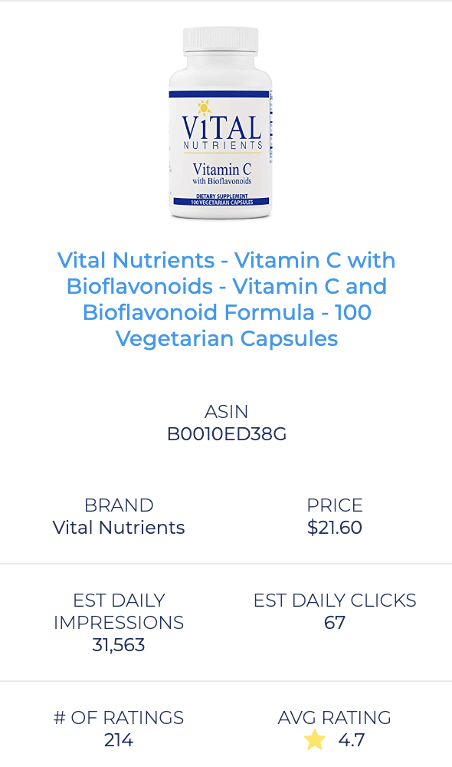
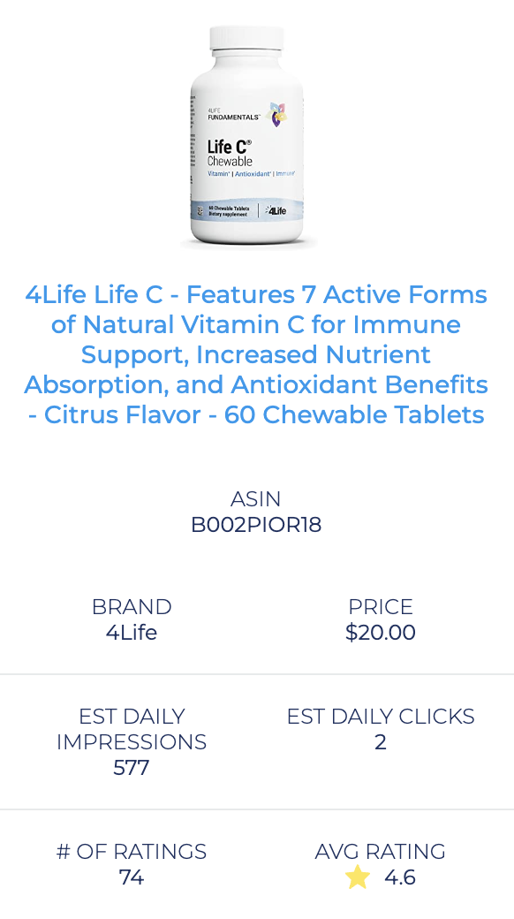
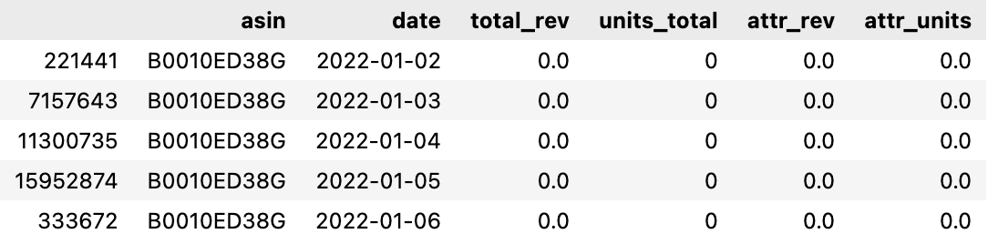


Example 1
Overview
Model
Solution
Results
Health & Household -> Vitamins, Minerals & Supplements -> Vitamin C
Treat Asin
Matched Asin
Note: The shaded interval means the advertising period
Wilcoxon Signed-Rank Test:
There is a statistically significant difference between the two paired samples.
Wilcoxon Signed-Rank Test:
No statistically significant difference is observed.

Slide 23






Example 2
Health & Household -> Diet & Sports Nutrition -> Nitric Oxide Boosters
Treat Asin
Matched Asin
Note: The shaded interval means the advertising period

Slide 24


Difference-in-Difference Widget
Results of 2 Similarity Models
Best Match

